Slide 1
Selenium
Selenium - Introduction
LEVEL – LEARNER

Slide 2
Srinivasan S - 309934
White Box Testing - CoE
Version 1 – 22/10/2013

Slide 3









Icons Used
Hands on Exercise
Questions
Tools
Coding Standards
Test Your Understanding
Reference
A Welcome Break
Demonstration
Contacts

Slide 4
Objectives
After this session you will get an idea about:
Test Automation
Pros and Cons
Different Automation Tools
Why Selenium?
What is Selenium?
Selenium’s Tool Suite
Selenium IDE
Selenium RC
Selenium WebDriver
Selenium Grid

Slide 5
Selenium
Chapter 1: Introduction

Slide 6

Test Automation
Its a much talked about topic in the world of software testing and quality.
Its a process of writing a computer program to do testing which needs to be done manually.
Simply its automating the manual testing process currently in use.

Slide 7
Test Automation - Pros and Cons
Pros
Cons
Less time consumption
Reliable
Reusable
Better Quality Software
Fast
Cost effective – Only in longer term projects
Expensive
Proficiency
Debugging
Maintenance

Slide 8

Different Automation Tools
QTP - HP
IBM Rational - IBM
Rational Robot - IBM
Selenium – Open Source
Test Professional –MS
WATIR – Open Source
WebUI Test Studio – Telerik
Test Partner – Micro Focus
Silk Test – Micro Focus
Ranorex - Ranorex GmbH
HTTP Test tool – Open Source
Test Complete - SmartBear

Slide 9


Why Selenium?
Open Source
Record and Playback
Supports multi domain languages
Supports different platforms
Cost saving

Slide 10
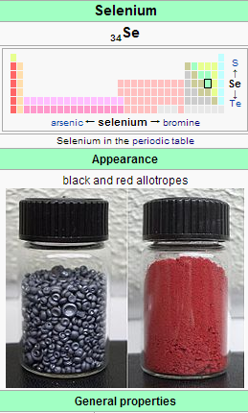

What is Selenium actually?
Selenium is a chemical element with symbol Se and atomic number 34.

Slide 11

What is Selenium for QE?
Selenium automates browsers. That's it.
Selenium is a suite of tools to automate web browsers across many platforms.
Selenium first came to life in 2004 when Jason Huggins was testing an internal application at ThoughtWorks.
A JavaScript library that could drive interactions with the page and to automatically rerun tests against multiple browsers
That library eventually became Selenium Core

Slide 12
Selenium
Chapter 2: Selenium’s Tool Suite

Slide 13



Selenium’s Tool Suite
Selenium IDE
Selenium RC
Selenium WebDriver
Selenium Grid

Slide 14
Selenium IDE
Is a Firefox plugin.
Has a recording and playback feature
Is a prototyping tool for building test scripts.
Provides an easy-to-use interface for developing automated tests.
Pros
Easy for first time users to understand how Selenium Works with the help of record and playback
Cons
Tests can be recorded and executed only in Firefox and not in other browsers.
Recorded scripts are only stored in table format
Cannot be customized with other OOPS programming languages.
Selenium IDE

Slide 15
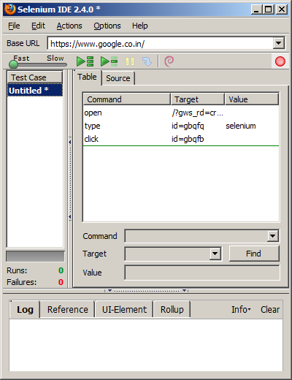
How Selenium IDE looks?
Record button which will start the recording of user actions
Place where the recorded commands are placed
Test Suites which consists of Test Cases

Slide 16
Selenium 1 (aka. Selenium RC or Remote Control)
Was the main Selenium project for a long time
RC Components
Selenium Server
Launches and kills browsers
Interrupts and runs the Selenese commands passed from test scripts
Acts as an HTTP proxy
Verifies HTTP messages passed between the browser and AUT
Client Libraries
Provides interface between OOPS languages and the Selenium RC Server
Running Selenium Server
java -jar selenium-server-standalone-<version-number>.jar
Selenium RC

Slide 17
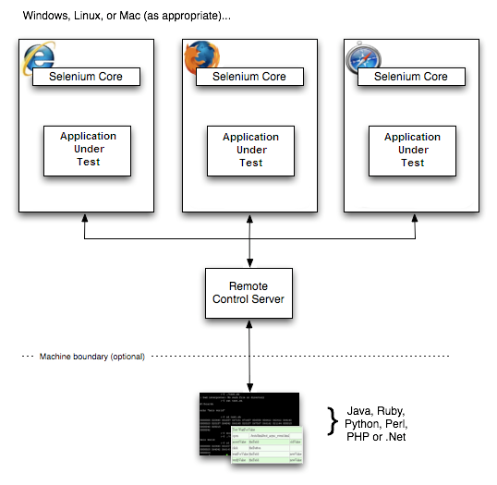
How Selenium RC Works

Slide 18
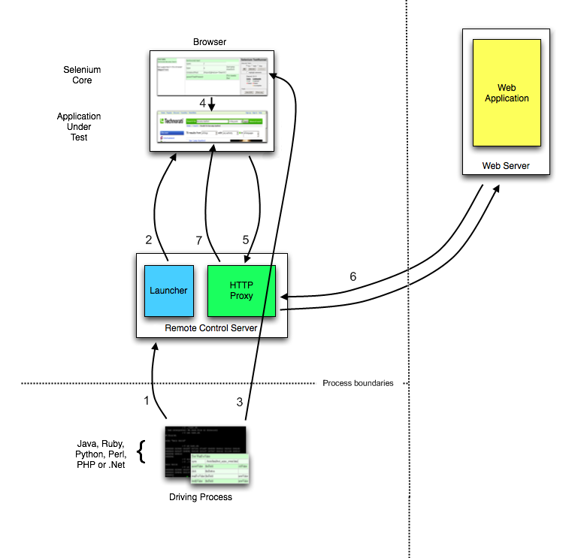
Selenium RC Architecture

Slide 19
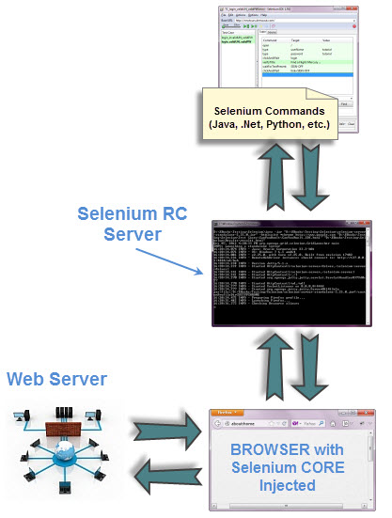
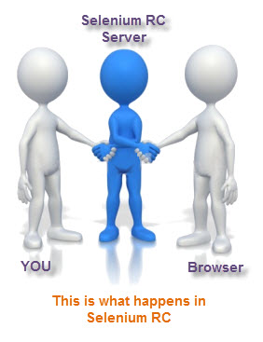
Selenium RC Architecture

Slide 20
Selenium RC: How to call Drivers
To call InternetExplorer Driver
selenium = new DefaultSelenium("localhost", 4444, "*iehta", "http://www.google.com/");
To call Firefox Driver
selenium = new DefaultSelenium("localhost", 4444, "*firefox", "http://www.google.com/");
To call Google Chrome Driver
selenium = new DefaultSelenium("localhost", 4444, "*chrome", "http://www.google.com/");

Slide 21
Selenium 2 (aka. Selenium Webdriver)
Selenium 2 is the future direction of the project and the newest addition to the Selenium toolkit.
New feature in Selenium 2.0 is the integration of the WebDriver API.
Goal is to supply a well-designed object-oriented API.
Provides improved support for modern advanced web-app testing problems.
It controls the browser from the OS level
WebDriver can support the headless HtmlUnit browser.
Cons
It cannot readily support new browsers, but Selenium RC can.
It does not have a built-in command for automatic generation of test results.
Selenium Webdriver

Slide 22
Selenium WebDriver Architecture
Focus on the User
WebDriver drives the browser from end user’s point of view.
Use a "Best Fit" Language
Each browser has a language that is most natural to use from an automation perspective. The various drivers are implemented as much as possible in that language.
A Layered Design
Developers should be able to write their tests in the supported language of their choice, and these tests should work with all driver implementations.
Browser | "Best Fit" Language
Firefox | Javascript in an XPCOM component
Internet Explorer | C++ mainly using the IE Automation APIs, but occasionally using other features of Windows

Slide 23

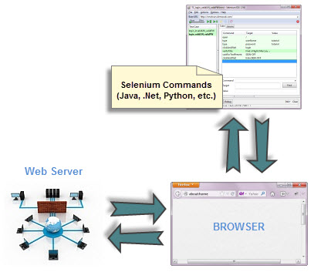
Selenium WebDriver Architecture

Slide 24
Selenium WebDriver : How to call Drivers
To call InternetExplorer Driver
IWebDriver driver = new InternetExplorerDriver();
To call Firefox Driver
IWebDriver driver = new FirefoxDriver();
To call Google Chrome Driver
IWebDriver driver = new ChromeDriver();

Slide 25
Selenium Grid
Allows you to run your tests on different machines against different browsers in parallel
When to Use It
To run your tests against multiple browsers, multiple versions of browser, and browsers running on different operating systems.
To reduce the time it takes for the test suite to complete a test pass.
Selenium Grid

Slide 26
How Selenium-Grid Works–With a Hub and Nodes
A grid consists of a single hub, and one or more nodes.
Both are started using the selenium-server.jar executable
Starting Selenium Grid
Starting a Hub
java -jar selenium-server-standalone-2.21.0.jar -role hub
Starting a Node
java -jar selenium-server-standalone-2.21.0.jar -role node -hub http://localhost:4444/grid/register
Selenium Grid

Slide 27



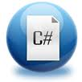








Selenium Supported Languages & Browsers

Slide 28






Selenium Supported Testing Frameworks

Slide 29
Test Your Understanding
What is Selenium?
What is Selenium IDE?
What is Selenium RC?
What is Selenium WebDriver?
What are the difference between them?
What is Selenium Grid?

Slide 30
Selenium IDE/RC/Webdriver Difference
Selenium IDE | Selenium RC | Selenium WebDriver
It only works in Mozilla browser. | It supports with all browsers like Firefox, IE, Chrome, Safari, Opera etc. | It supports with all browsers like Firefox, IE, Chrome, Safari, Opera etc.
It supports Record and playback | It doesn’t supports Record and playback | It doesn’t supports Record and playback
It is a GUI Plug-in | It is standalone java program which allow you to run Html test suites. | It actual core API which has binding in a range of languages.
Core engine is Javascript based | Core engine is Javascript based | Interacts natively with browser application
Very simple to use as it is record & playback. | It is easy and small API | As compared to RC, it is bit complex and large API.
….Continue

Slide 31
Selenium IDE/RC/Webdriver Difference
Selenium IDE | Selenium RC | Selenium WebDriver
It is not object oriented | API’s are less Object oriented | API’s are entirely Object oriented
It doesn’t supports of moving mouse cursors. | It doesn’t supports of moving mouse cursors. | It supports of moving mouse cursors.
Need to append full xpath with ‘xpath=\\’ syntax | Need to append full xpath with ‘xpath=\\’ syntax | No need to append full xpath with ‘xpath=\\’ syntax
It does not supports listeners | It does not supports listeners | It supports the implementation of listeners
It does not support to test iphone/Android applications | It does not support to test iphone/Android applications | It support to test iphone/Android applications

Slide 32
Summary
Selenium Introduction
Selenium IDE
Selenium RC
Selenium WebDriver
Difference between IDE, RC and WebDriver
Selenium Grid

Slide 33

Questions

Slide 34
Source
http://docs.seleniumhq.org/
Disclaimer: Parts of the content of this course is based on the materials available from the Web sites and books listed above. The materials that can be accessed from linked sites are not maintained by Cognizant Academy and we are not responsible for the contents thereof. All trademarks, service marks, and trade names in this course are the marks of the respective owner(s).

Slide 35
Selenium
You have successfully completed -
Selenium Basics

